Slide 1

Extending the Distributed Service Profiler
Shelley Lowe
4950257
BTech 451 Project

Slide 2
Problem
Kiwiplan developers currently use a Distributed Service Profiler to check calls made between various services
Helps developers improve their code by using the profiler to find problem areas
Calls to the database tends to be the bottleneck of the system so developers want to know which calls are taking the longest

Slide 3
Project Goal
To extend the capabilities of the profiling tool by adding integration with the Hibernate ORM and the database layer
Intercept calls made by the services to the database and display the query information in the window

Slide 4
Motivation
Some service methods spend a lot of time processing – majority of this time are queries to the database
Current profiler only displays this time under the service method, no information is given about the database calls
Developers want to know what/where queries are made to help find bottlenecks of the service and improve their code

Slide 5
Profiler - Background Information
The initial profiler was created by another BTech student a few years ago
Currently displays calls made between services and information of these calls
Information includes method name, time taken to process, argument and return bytes and number of hits

Slide 6
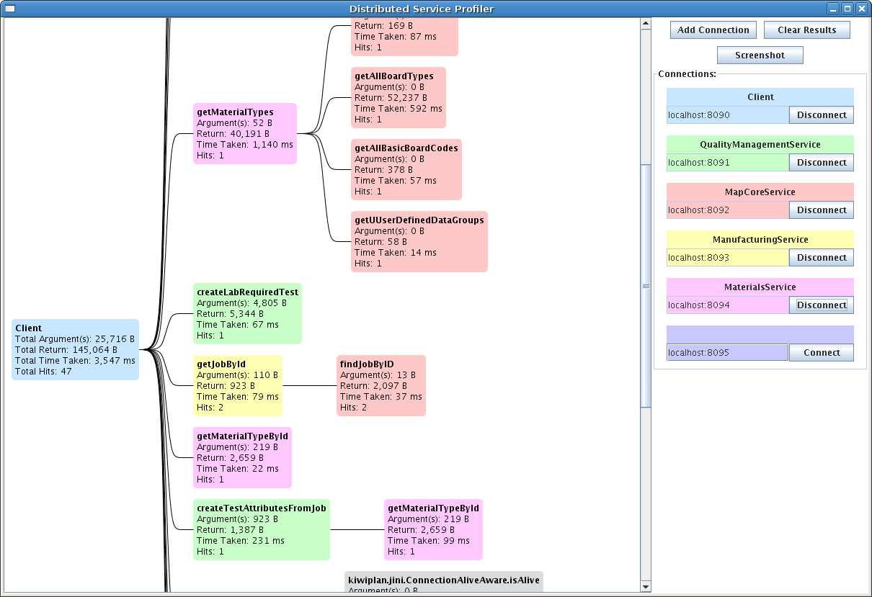
Profiler - Background Information

Slide 7
Work So Far
Created a Development Plan for the project. Includes specifications for the profiler and how the GUI will be extended to include database queries
Looking into source code of profiler and seeing how it can be extended
Research into Hibernate Interceptor
Research into HQL
Implementing an Interceptor

Slide 8
Hibernate Interceptor
Main tool I will use to intercept calls made to the database
Profiler will be configured to create a session and integrated with the Interceptor
Must create a class which extends the EmptyInterceptor class and implement necessary methods
Methods to implement – onSave(), onDelete(), etc

Slide 9
Hibernate Interceptor
Methods implemented in the Interceptor will be automatically called when queries are made to the database
onSave() is called when a session is saved and changes are made to the database

Slide 10
Project Plan
By the end of the semester, I hope to have a simple Hibernate Interceptor running
This Interceptor will be tested on simple database tables
This makes it easier to create and test the interceptor without having to integrate it with the profiler
I will also be doing research into logging and hibernate events

Slide 11
Project Plan - Research
I have started looking into how I can get information I need for the call tree
How to log SQL and HQL – can use SLF4J (Simple Logging Facade for Java), an abstraction for various logging frameworks
Matching service call with the call responding hibernate event
Transaction time

Slide 12
What I Hope to Gain
Improve my Java programming skills
Learning about Hibernate ORM
Experience with working on a real project
Preparing myself to be in a work environment
Learning about profiling tools

Slide 13
Questions??

